Slide 1





Git and GitHub
Version Control Systems
Programming Fundamentals
SoftUni Team
Technical Trainers
Software University
http://softuni.bg

Slide 2

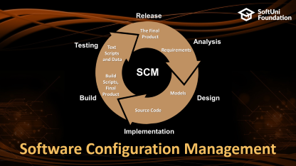


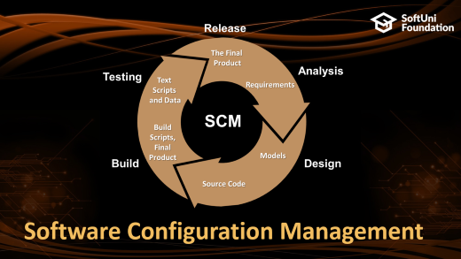

Table of Contents

Slide 3
Have a Question?
sli.do #tech-softuni

Slide 4
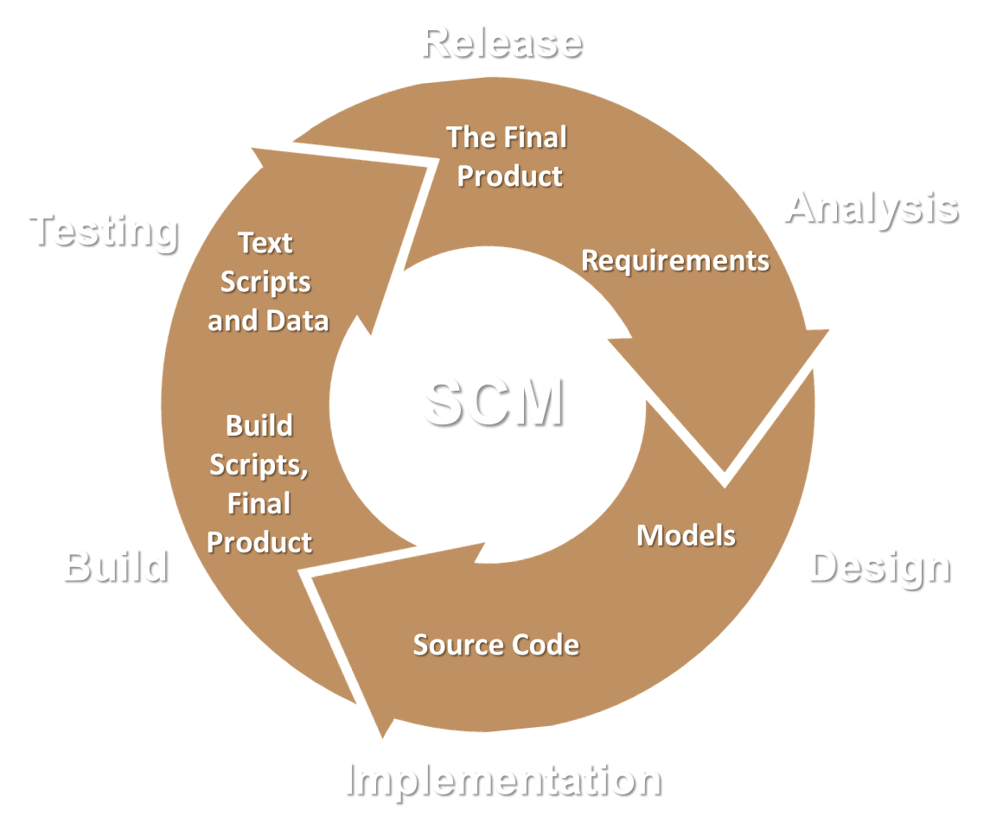
Software Configuration Management

Slide 5
Software Configuration Management (SCM)
Version Control ≈ Software Configuration Management (SCM)
A software engineering discipline
Consists of techniques, practices and tools for working on shared source code and files
Mechanisms for management, control and tracking the changes
Defines the process of change management
Keeps track of what is happening in the project over the time
Solves conflicts in the changes

Slide 6
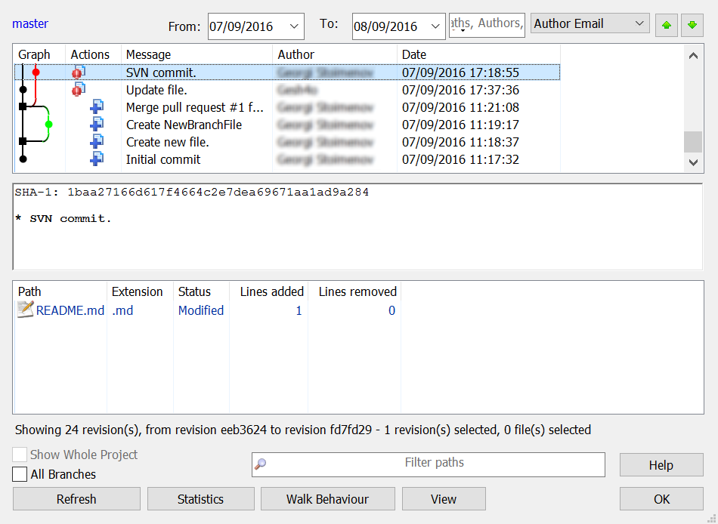
Change Log
Systems for version control keep a complete change log (history)
Who?
Why?
When?

Slide 7


Change Log (2)
Old versions are saved in the change log
Can be retrieved, examined and even reverted
Revert
Good version
Bad version

Slide 8


Vocabulary: Repository
Holds the project assets in a remote server
Remote
Local

Slide 9
Vocabulary: Clone
Download a local copy of the project
Clone
Remote
Local

Slide 10
Vocabulary: Commit
Store a set of changed files in the local repository
Commit

Slide 11


Vocabulary: Sync
Pull
Take & merge the changes from the remote repository
Push
Send local changes to the remote repository
Pull
Merge
Push
Conflict

Slide 12
Vocabulary: Branch
master
master
custom-branch

Slide 13
Vocabulary: Merge Branches
Conflict
master
master
custom-branch

Slide 14





Еxample: Branches

Slide 15

Git

Slide 16

What is Git?
Git == distributed source-control system
The most popular in the world
Free, open-source software
Works with local and remote repositories
Git bash – command line interface for Git
Runs on Linux, Mac OS and Windows (msysGit)
http://msysgit.github.io
https://www.atlassian.com/git/tutorials/setting-up-a-repository

Slide 17
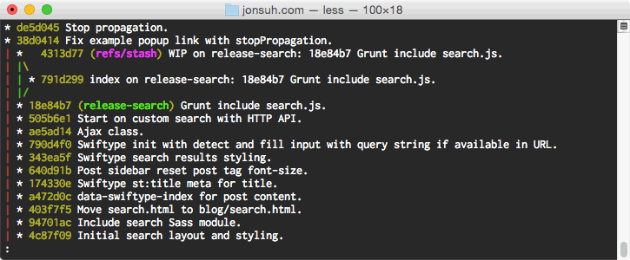
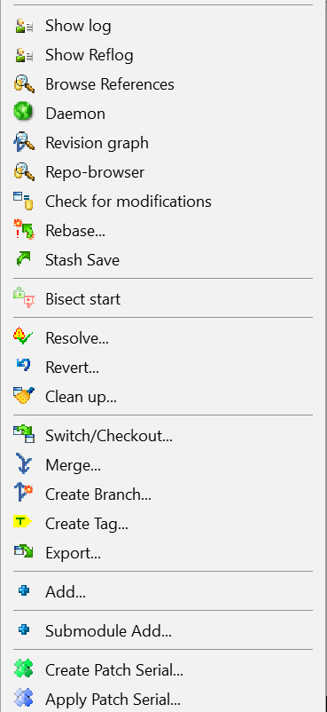
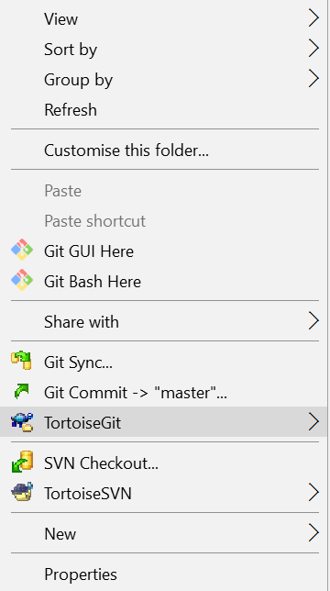
Using Git
Console-based client
git, GitBash
Windows GUI client – TortoiseGit
https://tortoisegit.org/download/
Visual Studio / Eclipse plug-ins
GitHub Desktop client
https://desktop.github.com

Slide 18


How It Works?
Pull
git add
Modified
Staged
Committed

Slide 19
How It Works?
Push
git commit
Modified
Staged
Committed

Slide 20
Installing Git
msysGit installation on Windows
Download Git for Windows: https://git-for-windows.github.io
“Next, Next, Next” does the installation
Options to select (they should be selected by default)
“Use Git Bash only”
“Checkout Windows-style, commit Unix-style endings”
Git installation on Linux:
sudo apt-get install git

Slide 21
Basic Git Commands
Cloning an existing Git repository
Fetch and merge the latest changes from the remote repository
Preparing (adding / selecting) files for a commit
Committing to the local repository
git clone [remote url]
git pull
git add [filename] ("git add ." adds everything)
git commit –m "[your message here]"

Slide 22
Basic Git Commands (2)
Check the status of your local repository (see the local changes)
Creating a new local repository (in the current directory)
Creating a remote (assign a short name for remote Git URL)
Pushing to a remote (send changes to the remote repository)
git status
git init
git remote add [remote name] [remote url]
git push [remote name] [local name]

Slide 23
Using Git Commands: Example
mkdir work
cd work
git clone https://github.com/SoftUni/test.git
dir
cd test
dir
git status
(edit some file)
git status
git add .
git commit -m "changes"
git push

Slide 24
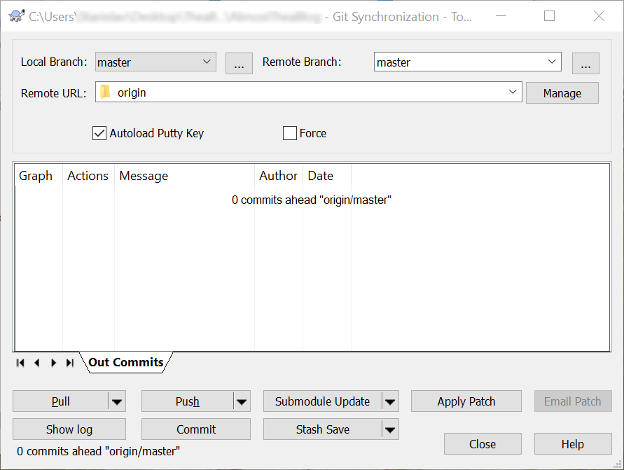
Using TortoiseGit: Example

Slide 25

GitHub
The Social Network for Developers

Slide 26
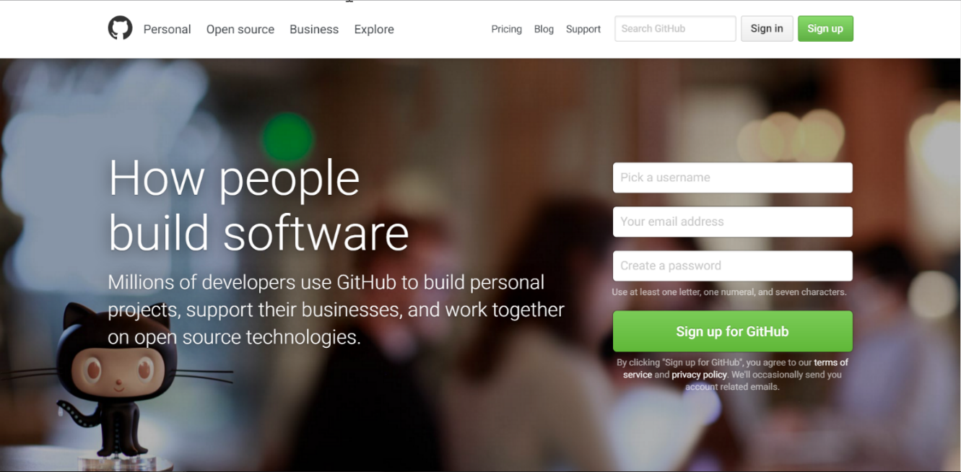
What is GitHub?
GitHub is the world's #1 source code hosting site
Free for open-source projects
Paid plans for private repositories
GitHub provides:
Git source code repository
Issue tracker (bug tracker)
Project board (Kanban style)
Wiki pages (documentation)

Slide 27
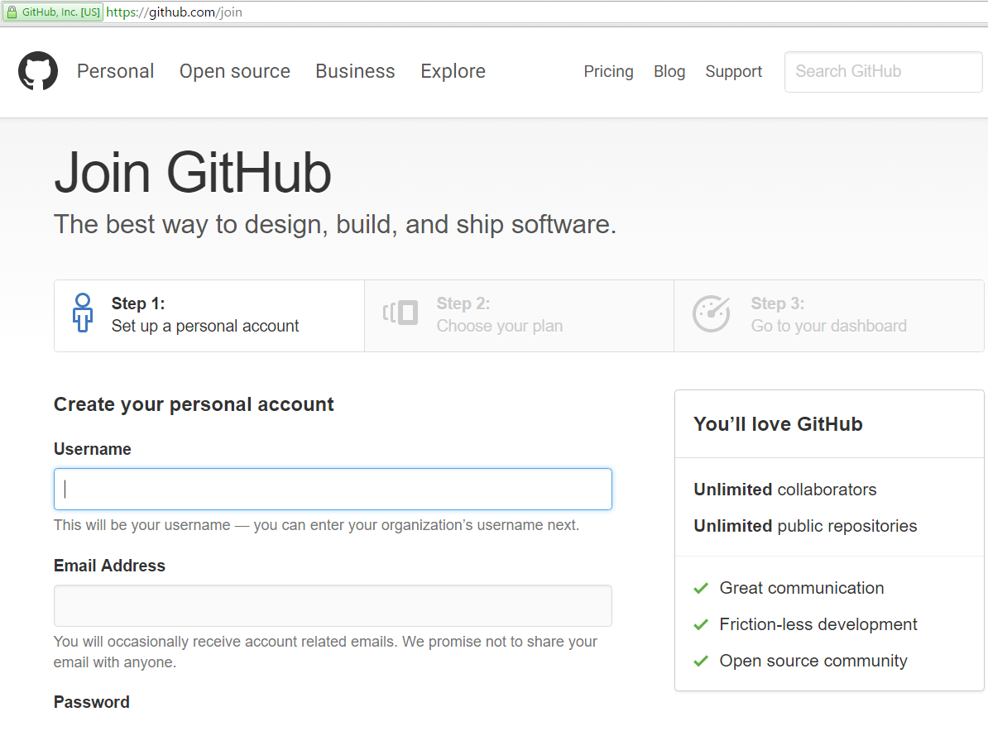
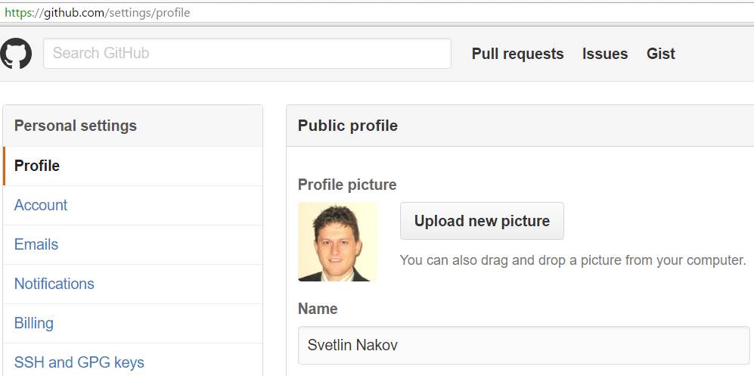
Exercise: Create Your Own Profile at GitHub

Slide 28

GitHub
Live Exercises in Class (Lab)

Slide 29

Exercises: Introduce Yourself
Make an acquaintance with your colleagues around you
Ask typical questions like:
What is your name?
Where are you from?
What is your occupation?
What are your goals at SoftUni?

Slide 30
Acquaintance with Your Colleagues
Live Exercises in Class (Lab)

Slide 31
Exercises: Create a Conflict (in Teams)
Work in teams of 5 students
Team lead: create a GitHub repository
All team members:
Clone the repository
Make some local changes
Commit all local changes
Push the changes to the remote repository
In case of conflict: pull remote changes (fetch + merge)

Slide 32
Play with GitHub
Live Exercises in Class (Lab)

Slide 33


Summary
Use version control systems to work in a team
Keep the code in a central repository
Handle merge conflicts with ease
Important Git commands:
clone, add, commit, pull, push
GitHub == the world's most used software project hosting platform
Git repository, issue tracker, Kanban board, Wiki

Slide 34







Programming Fundamentals – Git and GitHub
https://softuni.bg/courses/programming-fundamentals

Slide 35
License
This course (slides, examples, demos, videos, homework, etc.) is licensed under the "Creative Commons Attribution-NonCommercial-ShareAlike 4.0 International" license

Slide 36





Trainings @ Software University (SoftUni)
Software University – High-Quality Education, Profession and Job for Software Developers
softuni.bg
Software University Foundation
http://softuni.foundation/
Software University @ Facebook
facebook.com/SoftwareUniversity
Software University Forums
forum.softuni.bg

